Slide 1


DevOps internal course
Cloud Providers.
MS Azure Overview.
Since 2002 on the market
22 years in Cybersecurity
350+ employees

Slide 2

Agenda
What are cloud providers?
Cloud providers pros & cons.
Free account creation.
High level MS Azure features overview.
Homework.
Since 2002 on the market
21 years in Cybersecurity
350+ employees

Slide 3
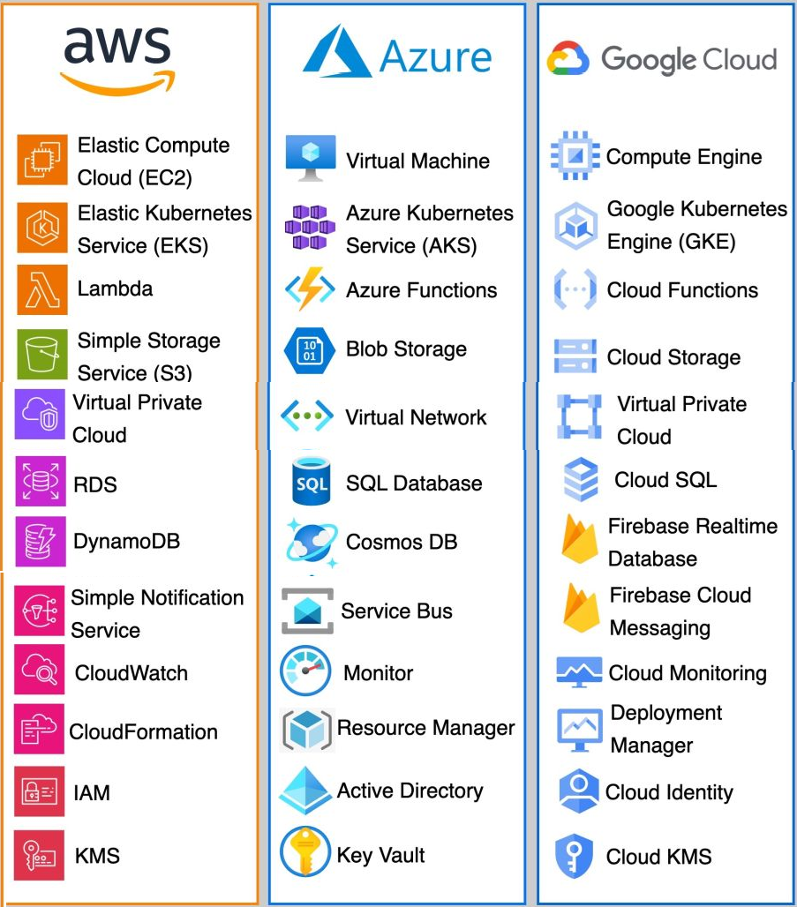
CSP - cloud service provider
A CSP (cloud service provider) is a third-party company that provides scalable computing resources that businesses can access on demand over a network, including cloud-based compute, storage, platform, and application services.
Since 2002 on the market
21 years in Cybersecurity
350+ employees

Slide 4
Advantages of using a CSP
1. Business agility
2. Reduced costs
3. Scalability
4. Reliability
5. Centralized location
6. Future-proof systems
7. Improved mobility
8. Disaster recovery
Since 2002 on the market
21 years in Cybersecurity
350+ employees

Slide 5
Disadvantages of using a CSP
1. Understanding the Costs
2. Moving From Cloud to On-Premises
3. Limited Control
4. Vendor Lock-In
5. Slower Backups and Restores
6. Internet Reliance
7. Internet Use
Since 2002 on the market
21 years in Cybersecurity
350+ employees

Slide 6
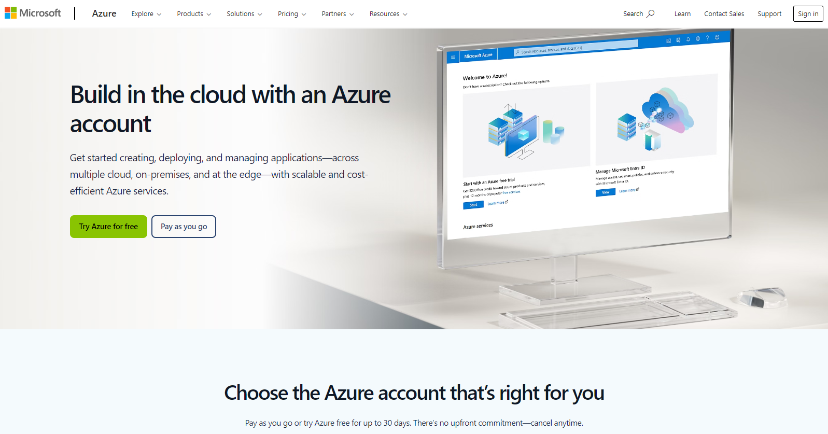
Free account creation in Azure
https://azure.microsoft.com/en-us/pricing/purchase-options/azure-account?icid=azurefreeaccount
Since 2002 on the market
21 years in Cybersecurity
350+ employees

Slide 7
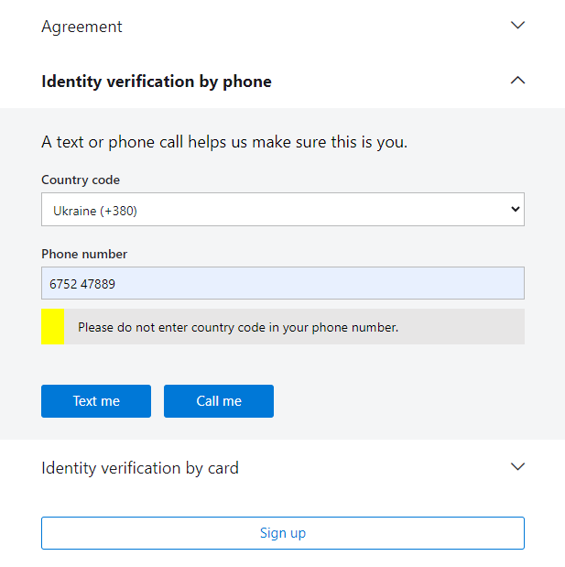
Verification by phone
Since 2002 on the market
21 years in Cybersecurity
350+ employees

Slide 8
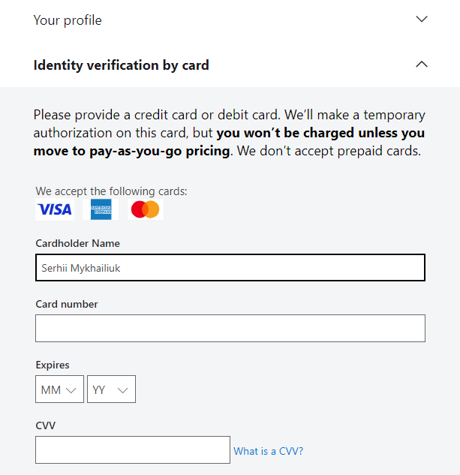
Verification by card.
Since 2002 on the market
21 years in Cybersecurity
350+ employees

Slide 9
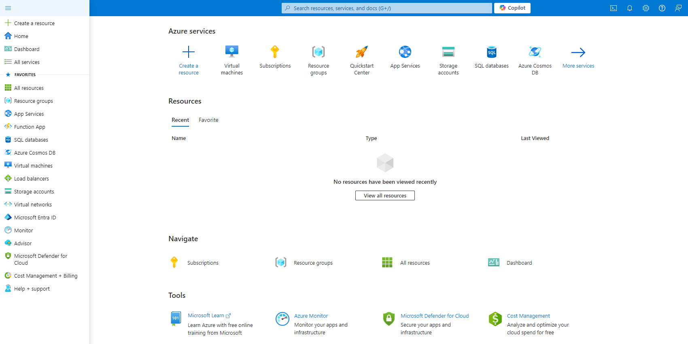
High level MS Azure features overview
Since 2002 on the market
21 years in Cybersecurity
350+ employees

Slide 10
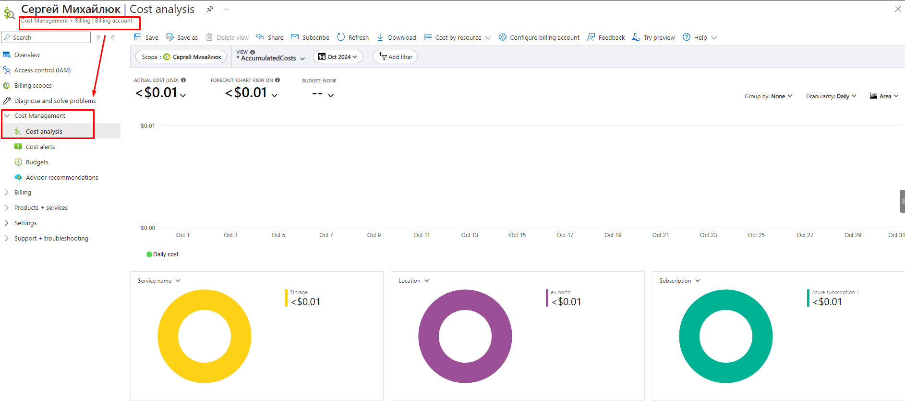
Cost Management + Billing
Since 2002 on the market
21 years in Cybersecurity
350+ employees

Slide 11
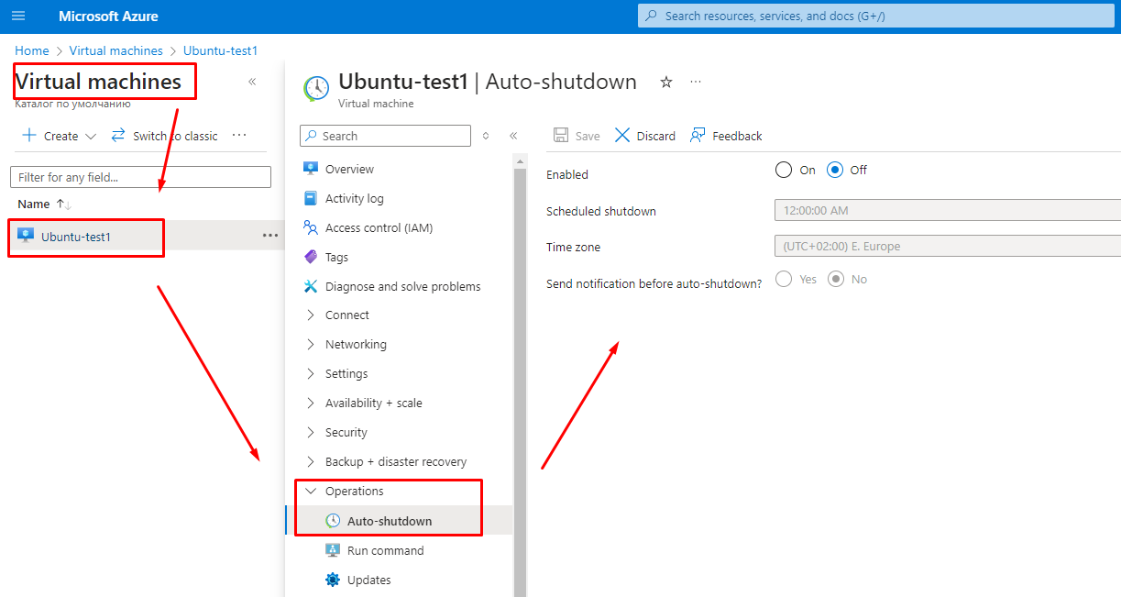
Virtual machine. Auto-shutdown
Since 2002 on the market
21 years in Cybersecurity
350+ employees

Slide 12
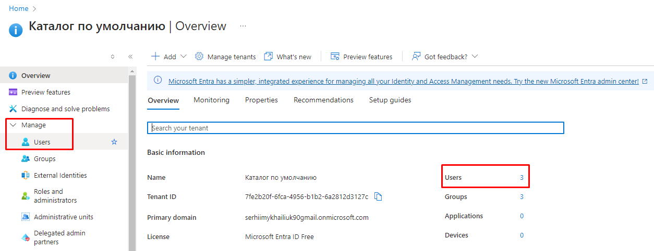
Microsoft Entra ID. Users
Since 2002 on the market
21 years in Cybersecurity
350+ employees

Slide 13
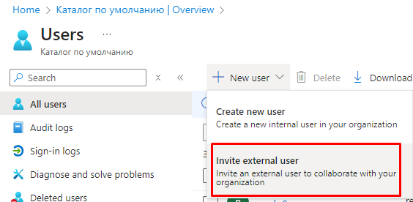
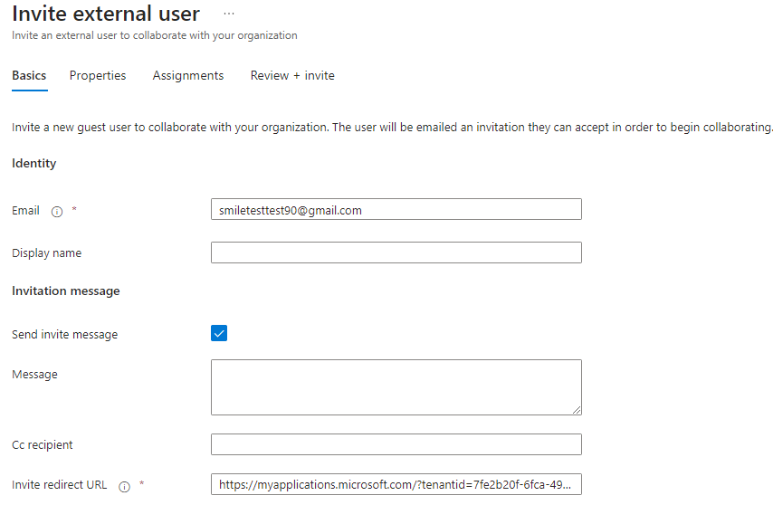
Microsoft Entra ID. Invite external user
Since 2002 on the market
21 years in Cybersecurity
350+ employees

Slide 14
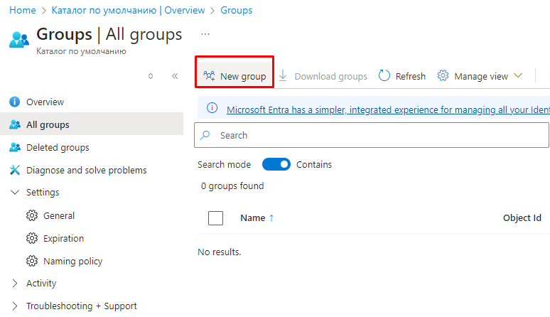
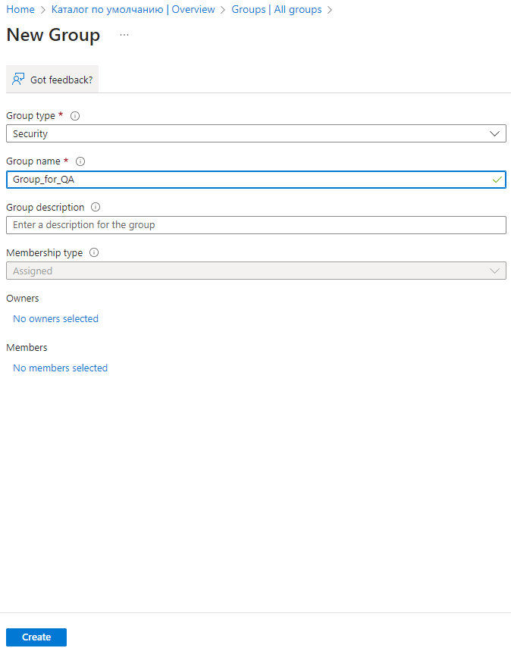
Microsoft Entra ID. New group
Since 2002 on the market
21 years in Cybersecurity
350+ employees

Slide 15
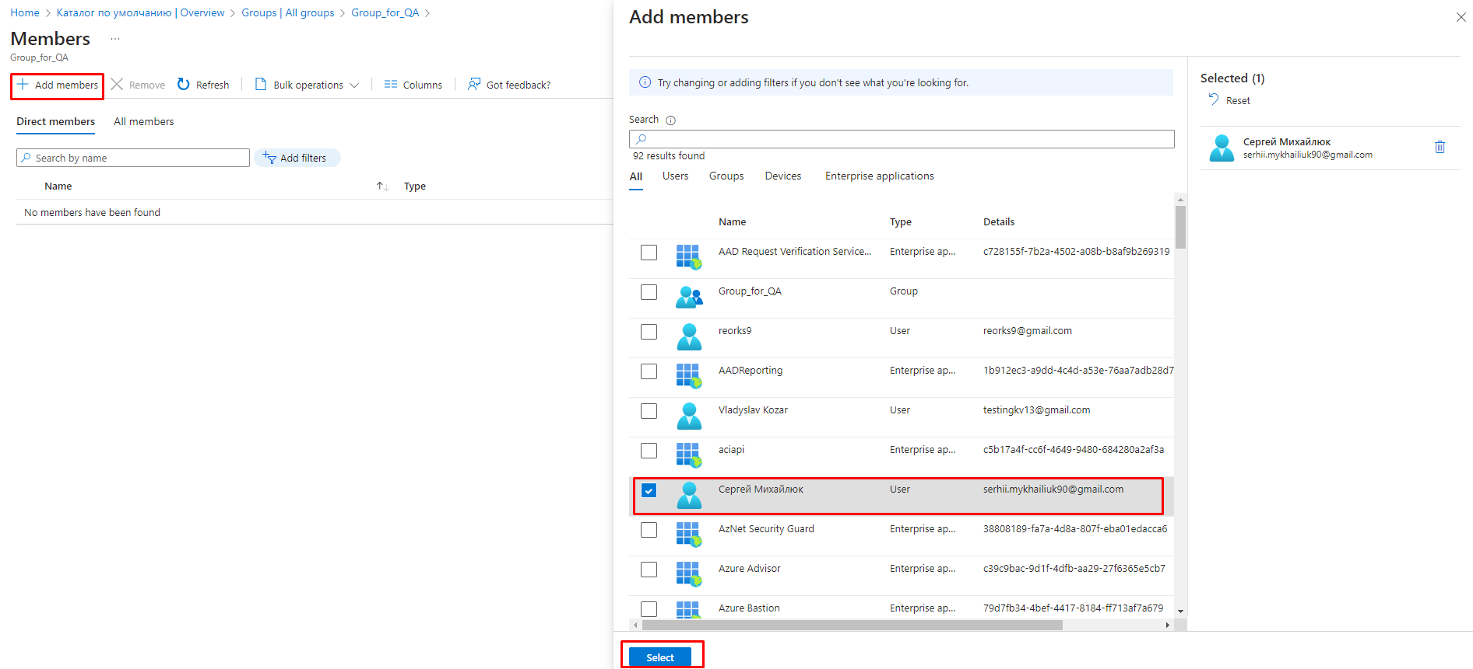
Microsoft Entra ID. Add user to the group
Since 2002 on the market
21 years in Cybersecurity
350+ employees

Slide 16
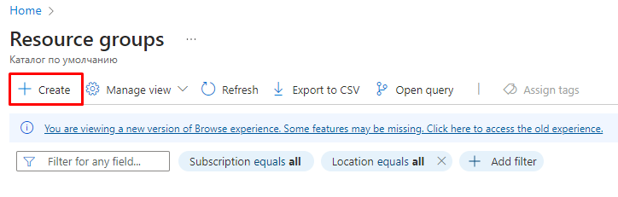
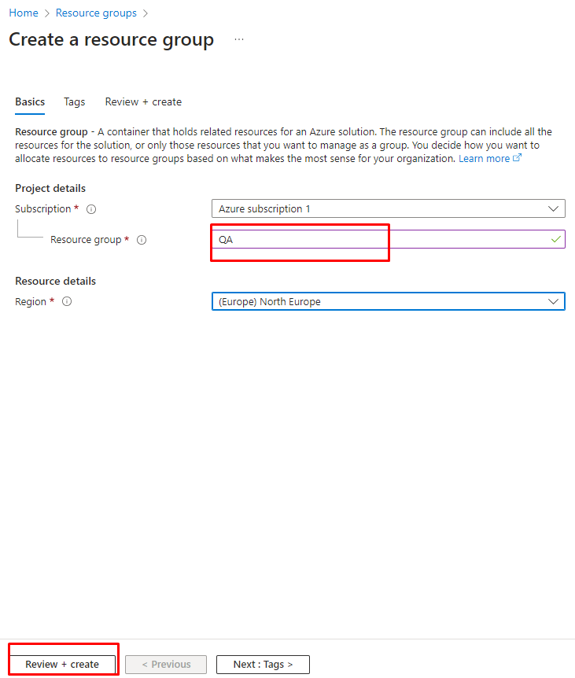
Create a resource group
Since 2002 on the market
21 years in Cybersecurity
350+ employees

Slide 17
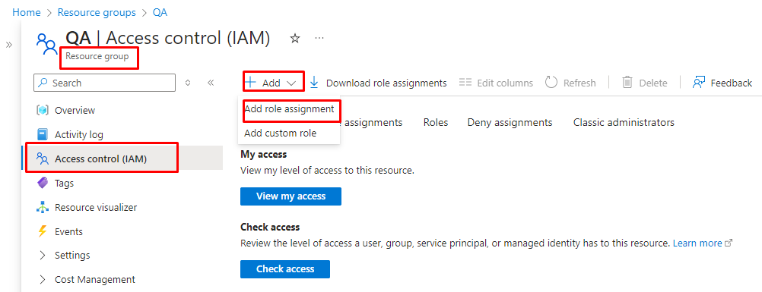
Resource group. Access control
Since 2002 on the market
21 years in Cybersecurity
350+ employees

Slide 18
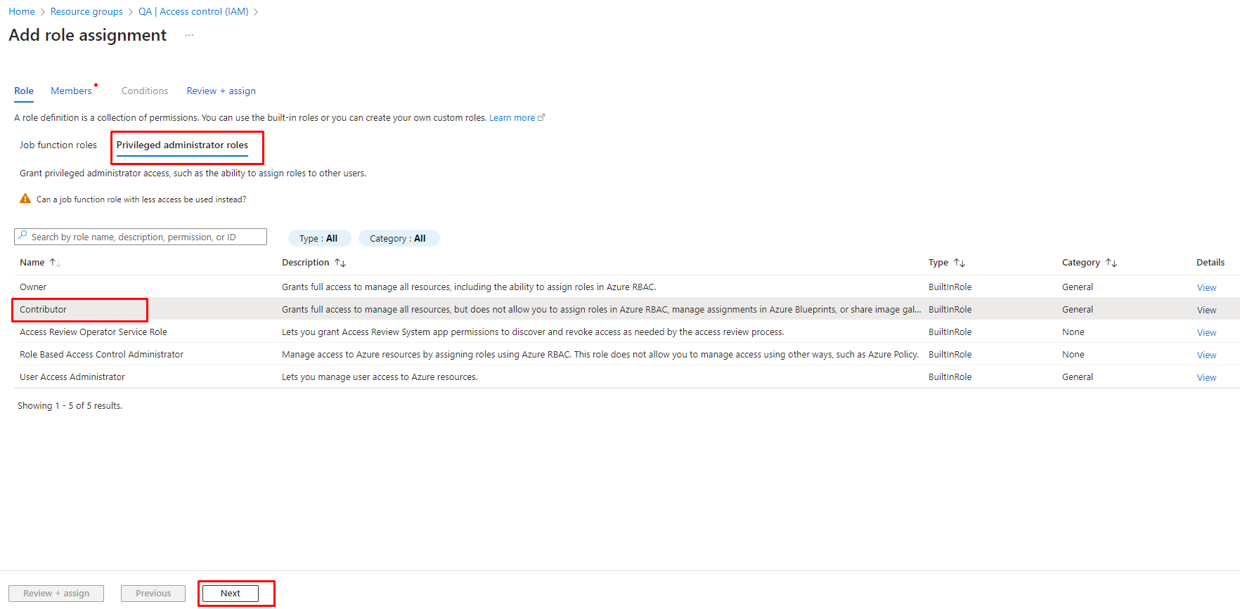
Resource group. Access control. Add role
Since 2002 on the market
21 years in Cybersecurity
350+ employees

Slide 19
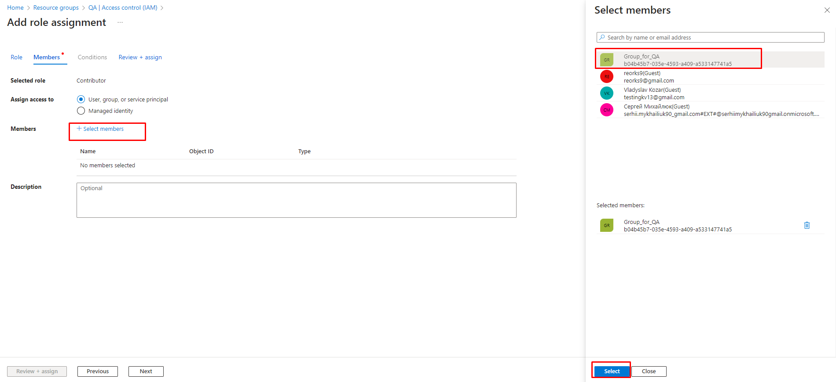
IAM. Add role assignment for group/user
Since 2002 on the market
21 years in Cybersecurity
350+ employees

Slide 20
Homework
1. Create an Azure free account.
2. Get acquainted with basic Azure UI.
3. Create a resource group, create any object in it (VM, storage account). Create a group, user, add user to the group, send an invite to serhii.mykhailiuk90@gmail.com.
Since 2002 on the market
21 years in Cybersecurity
350+ employees

Slide 21


Any questions?
Since 2002 on the market
21 years in Cybersecurity
350+ employees

Slide 22






Thank you!
If you have any questions , please contact us at
info@apriorit.com
www.apriorit.com
Follow us on social media:
www.linkedin.com/company/apriorit
www.twitter.com/Apriorit
www.softwareengineeringblog.quora.com
www.facebook.com/apriorit
Since 2002 on the market
21 years in Cybersecurity
350+ employees

